Slide 1

A review of good practice and remediable factors in the delivery of care provided to children and young people under 18 years old undergoing emergency (non-elective) surgery under anaesthetic or sedation.
Key messages and recommendations

Slide 2
The study
Study population:
All children and young people aged 0–18th birthday who underwent an emergency (non-elective) procedure under anaesthetic or sedation were identified between 17/06/24 to 30/06/24 June and 12/02/24 to 25/02/24. Patients were identified across two-time frames to account for seasonal variation.
Data sources:
679 surgical questionnaires
760 anaesthetic questionnaires
36 transfer questionnaires
853 case notes
143 organisational questionnaires

Slide 3
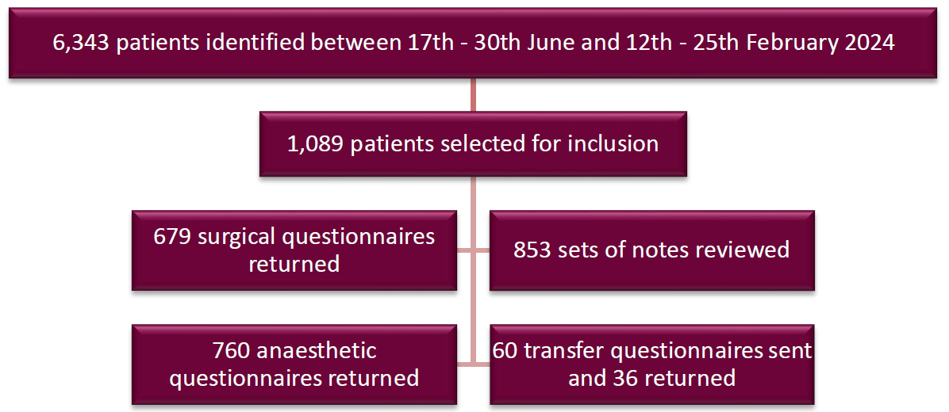
Data Returns
6,343 patients identified between 17th - 30th June and 12th - 25th February 2024
760 anaesthetic questionnaires returned
60 transfer questionnaires sent and 36 returned

Slide 4
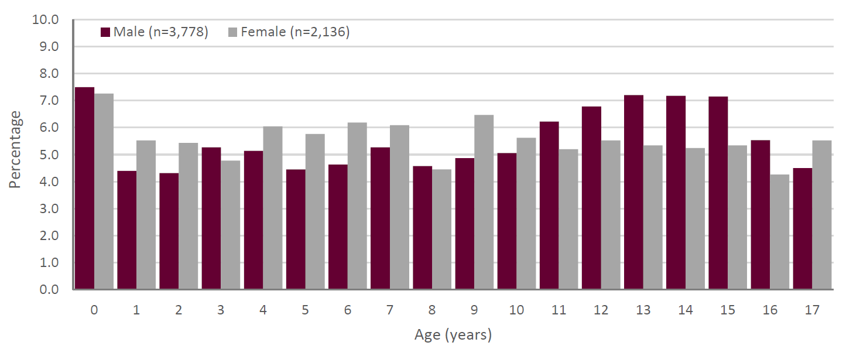
Age and Sex of Study Population

Slide 5
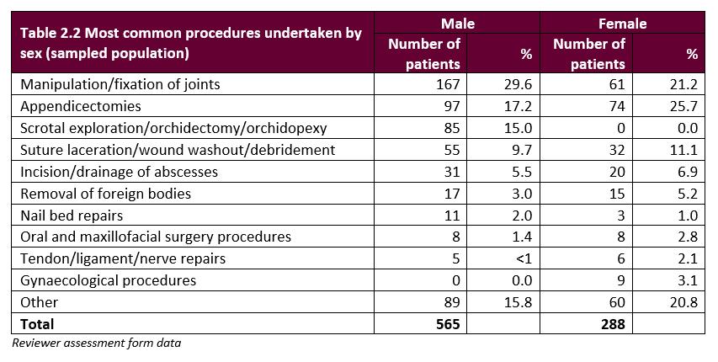
Procedures Undertaken

Slide 6
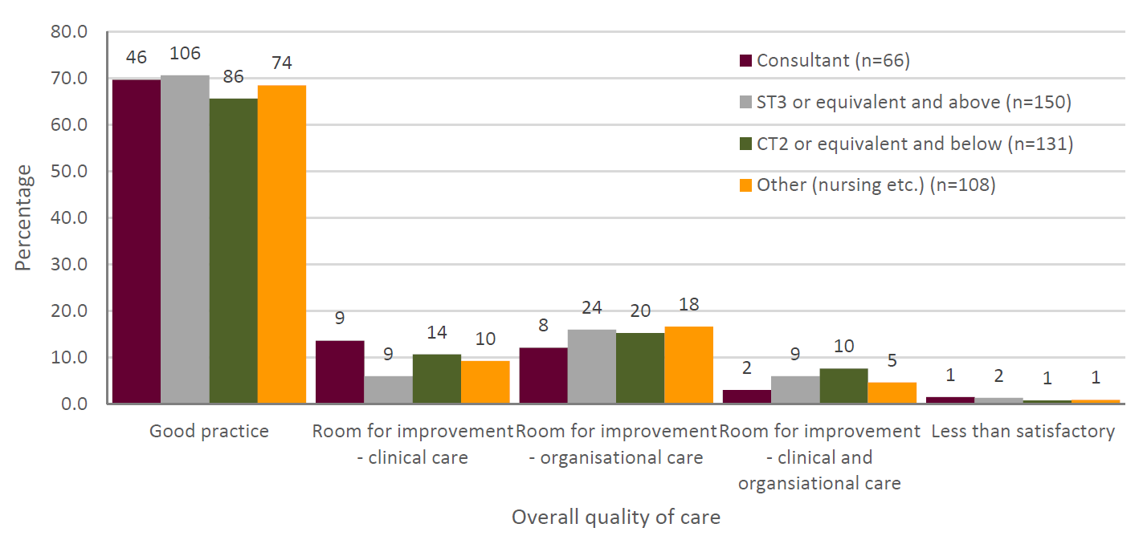
Overall Quality of Care
Notes:
The quality-of-care grading by the reviewers for emergency admission and postoperative hyponatraemia is shown in the above figure. For both groups of patients, the main areas for improvement related to clinical issues rather than organisational issues (emergency admission: 133/265; 50.2% and postoperative: 51/83; 61.4%)

Slide 7
KEY MESSAGES

Slide 8

1
PROVIDE PROMPT ACCESS TO EMERGENCY SURGICAL AND ANAESTHETIC CARE BY SPECIALISTS WITH THE RELEVANT TRAINING AND EXPERIENCE IN PROVIDING CARE TO CHILDREN AND YOUNG PEOPLE UP TO THE AGE OF 18 YEARS.
Networks were under used resulting in surgeons and anaesthetists in the non-specialist centres often feeling they did not have the right skills or experience to treat a patient, but they had no formal option to transfer the patient.
There were 19/143 (13.3%) hospitals not part of a network of care for non-elective procedures in children and young people. Most hospitals reported transferring patients out for surgery (133/143; 93.0%).
Only 287/629 (45.6%) patients were commenced on a dedicated pathway for emergency surgery in children and young people. Many of the patients who were not, should have been (83/255; 32.5%).

Slide 9
2
ONE OR MORE EMERGENCY SURGERY CO-ORDINATORS SHOULD BE IN PLACE TO ENSURE THAT CHILDREN AND YOUNG PEOPLE NEEDING EMERGENCY SURGERY CAN ACCESS A THEATRE.
Care was shown to be better in centres where an emergency surgery co-ordinator was available, but there was not always someone in this role and furthermore, theatre booking systems rarely highlighted breaches.
Reviewers reported that while the majority of patients had their procedures booked without delays (722/756; 95.5%) (unknown for 97), 19/34 patients experienced delays with/in the surgical team.
Theatre co-ordinating managers or clinicians were only available in 60/143 (42.0%) hospitals.
Only 52/143 (36.4) hospitals had a clinician responsible for assessing capacity in theatres on a daily basis.

Slide 10
3
PREVENT CHILDREN AND YOUNG PEOPLE WHO ARE WAITING FOR EMERGENCY SURGERY FROM BEING FASTED FOR ANY LONGER THAN NECESSARY.
Fasting was infrequently recorded in hospital policies for emergency procedures for children and young people, with many patients being fasted for too long prior to surgery.
In the opinion of the reviewers, 125/718 (17.4%) patients were fasted for too long, with those who underwent an expedited procedure most likely to be in this category.
Pre-procedure preparation was adequate for most patients (798/853; 93.6%), however, fasting (10/55) was the most common area for optimisation.

Slide 11

RECOMMENDATIONS

Slide 12
Provide prompt access to emergency surgical and anaesthetic care by specialists with the relevant training and experience in providing care to children and young people by:
Formalising organisational networks^{i} to define where children and young people are assessed and/or undergo an emergency procedure^{ii}, and to agree pathways of care based on age and condition.
Formalising clinical specialist networks for advice as needed.
i Utilising existing operational delivery networks or equivalent where possible.
ii For example, whether the procedure can be undertaken locally or whether the patient needs to be transferred to a specialist centre. This will require local and regional networks working together to ensure co-ordination of services.
For action by: Operational delivery networks or equivalent, commissioners and integrated care boards working with trusts/health boards.
Additional stakeholders: Hospital trusts/health boards, ambulance trusts, transport teams, Getting it Right First Time, British Association of Paediatric Surgeons, Association of Paediatric Anaesthetists of Great Britain and Ireland, Royal College of Surgeons of England, Royal College of Anaesthetists, Association of Surgeons of Great Britain and Ireland, Association of Anaesthetists, Royal College of General Practitioners, Royal College of Paediatrics and Child Health, Royal College of Nursing, Royal College of Emergency Medicine, Association of Paediatric Emergency Medicine, Royal College of Radiologists, British Society of Paediatric Radiology, College of Paramedics, Joint Royal Colleges Ambulance Liaison Committee, Association of Ambulance Chief Executives, British Society of Neurosurgeons, British Paediatric Neurology Association, British Association of Oral and Maxillofacial Surgeons, British Orthopaedic Association, British Society for Children’s Orthopaedic Surgery, British Association of Urological Surgeons, British Association of Paediatric Urologists, British Association for Paediatric Otorhinolaryngology, ENT UK, Royal College of Obstetricians and Gynaecologists, British Association of Plastic, Reconstructive and Aesthetic Surgeons.
Notes:
RATIONALE FOR THE RECOMMENDATION: Networks were under used and surgeons/anaesthetists who were not specialists often did not feel skilled to treat patients in the non-specialist centres but had no formal transfer option. Joined-up care is important in the recognition of the deteriorating patient and the escalation of care.

Slide 13
One or more co-ordinators should be in place to ensure that:
Children and young people needing emergency surgery have timely access* to a theatre
**NCEPOD classification of intervention
Patients who were not operated on within their prioritisation period are highlighted and the issue escalated to senior management with responsibility for patient safety/governance*
*If there are regular breaches for urgent and expedited patients due to emergency operating demands exceeding available resources, then alternative ways of dealing with this should be considered (e.g. planned urgent lists (hotlists) to prevent recurrence of future delays).
For action by: Commissioners and integrated care boards working with their trusts/health boards.
Additional stakeholders: Hospital trusts/health boards, British Association of Paediatric Surgeons, Association of Paediatric Anaesthetists of Great Britain and Ireland, Royal College of Surgeons of England, Royal College of Anaesthetists, Association of Surgeons of Great Britain and Ireland, Association of Anaesthetists, College of Operating Department Practitioners, Association for Perioperative Practice, British Society of Neurosurgeons, British Paediatric Neurology Association, British Association of Oral and Maxillofacial Surgeons, British Orthopaedic Association, British Society for Children’s Orthopaedic Surgery, British Association of Urological Surgeons, British Association of Paediatric Urologists, British Association for Paediatric Otorhinolaryngology, ENT UK,
Notes:
RATIONALE FOR THE RECOMMENDATION: Care was shown to be better in centres where there was a co-ordinator. Anaesthetic guidelines recommend having theatre co-ordinating managers or clinicians. Theatre booking systems did not highlight breaches.

Slide 14
Prevent children and young people who are waiting for emergency surgery from being fasted for any longer than necessary.
In the absence of likely gastric stasis, ‘Sip til Send’ could be considered but note that this was not developed for emergency procedures nor in children and young people. There is new evidence around fasting in paediatric care e.g. the EUROFAST trial.
For action by: Commissioners/integrated care boards with the hospitals in their trusts/health boards
Additional stakeholders: Hospital trusts/health boards, British Association of Paediatric Surgeons, Association of Paediatric Anaesthetists of Great Britain and Ireland, Royal College of Surgeons of England, Royal College of Anaesthetists, Association of Surgeons of Great Britain and Ireland, Association of Anaesthetists, College of Operating Department Practitioners, Association for Perioperative Practice, British Society of Neurosurgeons, British Paediatric Neurology Association, British Association of Oral and Maxillofacial Surgeons, British Orthopaedic Association, British Society for Children’s Orthopaedic Surgery, British Association of Urological Surgeons, British Association of Paediatric Urologists, British Association for Paediatric Otorhinolaryngology, ENT UK, Royal College of Obstetricians and Gynaecologists, British Association of Plastic, Reconstructive and Aesthetic Surgeons.
Notes:
RATIONALE FOR THE RECOMMENDATION: Children and young people were often fasted for too long and fasting was infrequently recorded in hospital policies for emergency procedures for children and young people.

Slide 15


Slide 16
REPORT AND TOOLS
www.ncepod.org.uk/2025eps.html
Report
Summary
Infographic
Recommendation checklist
Audit tool
Driver diagram
Fishbone diagram
Commissioners guide

